Slide 1
Sentiment Analysis of Airline Reviews in Twitter Using NLP
Jossa Soto
501074572
Dr. Tamer Abdou
April 4, 2022

Slide 2
Natural Language Processing: Sentiment Analysis
NLP: ability of a program to understand human language as it is spoken and written
Sentiment analysis: use of NLP and text analysis to identify, extract, and understand the sentiment made in documents
https://www.nytimes.com/2014/08/10/magazine/who-made-that-twitter-bird.html
https://www.davemanuel.com/2016/11/15/warren-buffett-airline-stocks/

Slide 3

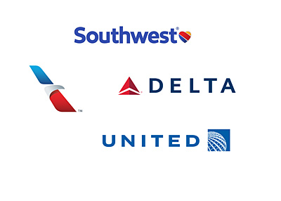
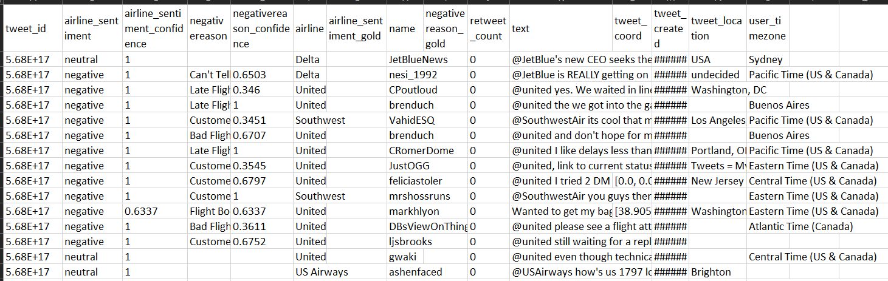
Dataset
Tweets about/to airlines from February 15-24, 2015
Candidate for supervised learning – contains sentiment class variable: positive, negative, neutral
Imbalanced towards negative and neutral tweets
Eight, F. (2019, October 16). Twitter us airline sentiment. Kaggle. Retrieved January 20, 2022, from https://www.kaggle.com/crowdflower/twitter-airline-sentiment
https://www.nytimes.com/2014/08/10/magazine/who-made-that-twitter-bird.html
https://www.davemanuel.com/2016/11/15/warren-buffett-airline-stocks/

Slide 4

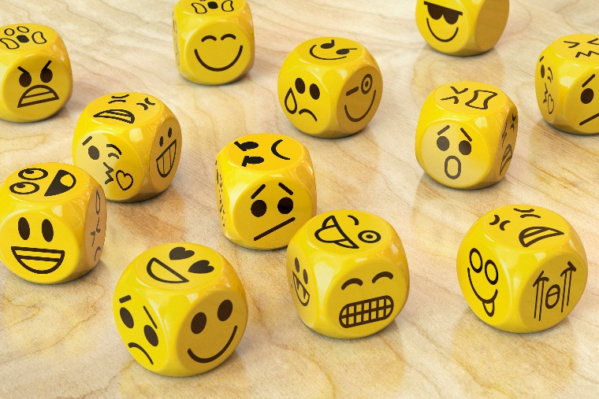
Research Questions
Differences between three classifiers: Decision Tree, Random Forest, Naïve Bayes
Performance of the three classifiers – which is the “best” classifier for unique documents such as tweets
Most common words associated to each sentiment in tweets
https://www.nytimes.com/2014/08/10/magazine/who-made-that-twitter-bird.html
https://www.davemanuel.com/2016/11/15/warren-buffett-airline-stocks/

Slide 5
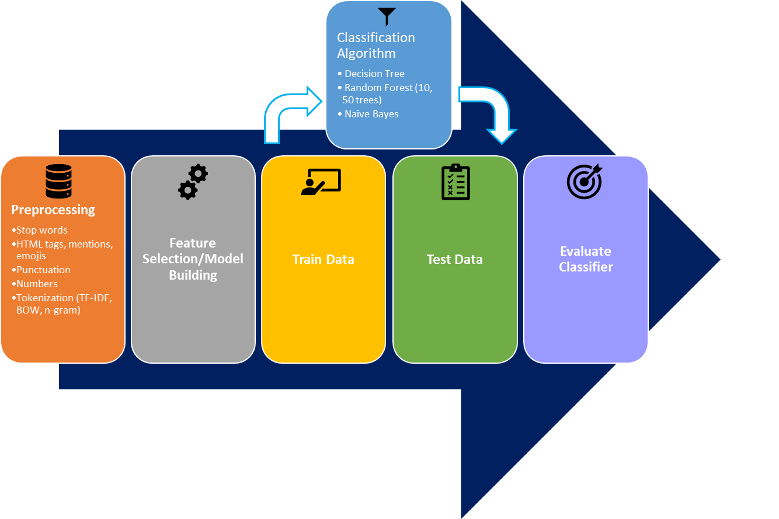


Methodology
https://commons.wikimedia.org/wiki/File:R_logo.svg
https://www.rstudio.com/about/logos/

Slide 6
Preprocessing and Document Tokenization
Preprocessing:
Stop Words
HTML tags, mentions, URLs, emojis
Numbers
Punctuations
Tokenization techniques:
TF-IDF Weights
Bag-of-Words (BOW)
Unigram
TF-IDF Weights
DOCS | even | ever | fli | just | never | bag
15 | 0 | 0 | 0 | 0.5671 | 0 | 0
16 | 0 | 0 | 0 | 0 | 0 | 0
17 | 0 | 0 | 0 | 0 | 0 | 0
18 | 0 | 0.5612 | 0.3933 | 0 | 0 | 0
19 | 0 | 0 | 0 | 0.3054 | 0 | 0.3759
20 | 0 | 0 | 0 | 0 | 0 | 0
Bag-of-Words
DOCS | even | ever | fli | just | never | bag
15 | 0 | 0 | 0 | 1 | 0 | 0
16 | 0 | 0 | 0 | 0 | 0 | 0
17 | 0 | 0 | 0 | 0 | 0 | 0
18 | 0 | 1 | 1 | 0 | 0 | 0
19 | 0 | 0 | 0 | 1 | 0 | 1
20 | 0 | 0 | 0 | 0 | 0 | 0
Unigram
DOCS | even | ever | fli | just | never | bag
15 | 0 | 0 | 0 | 1 | 0 | 0
16 | 0 | 0 | 0 | 0 | 0 | 0
17 | 0 | 0 | 0 | 0 | 0 | 0
18 | 0 | 1 | 1 | 0 | 0 | 0
19 | 0 | 0 | 0 | 1 | 0 | 1
20 | 0 | 0 | 0 | 0 | 0 | 0

Slide 7
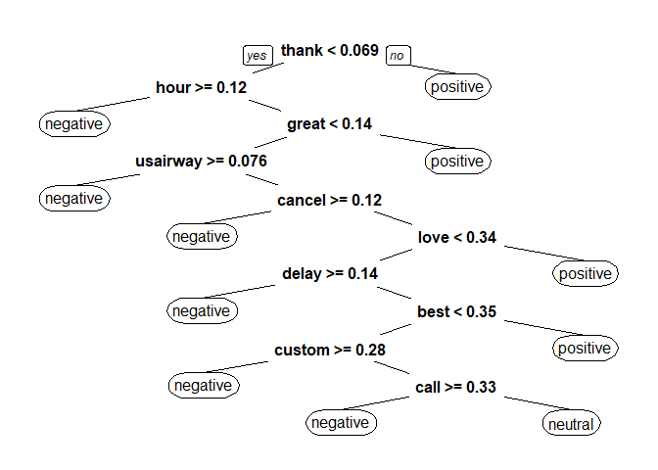
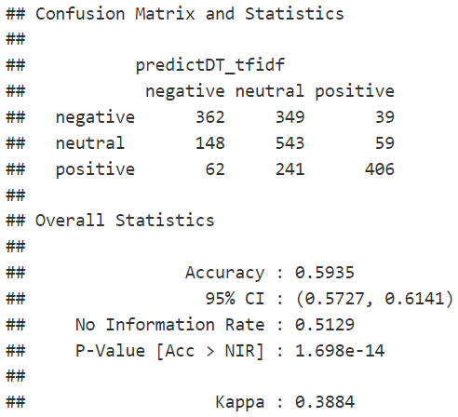
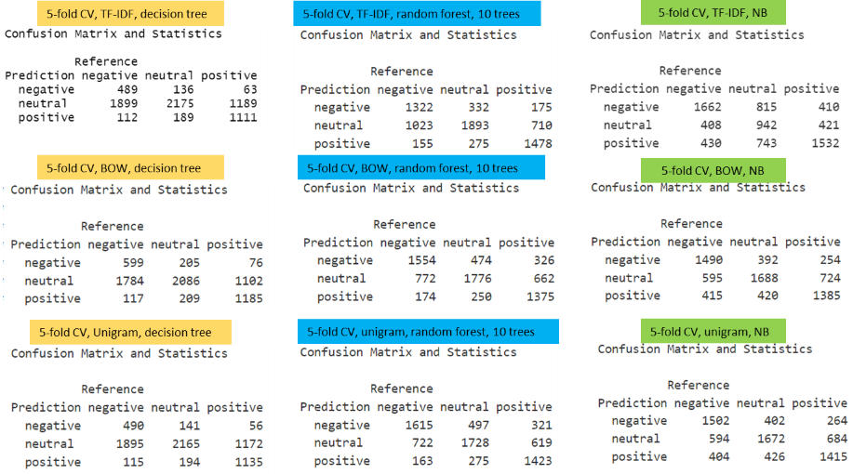
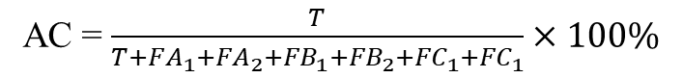
Confusion Matrices and Accuracy Scores
Decision Tree – TF-IDF weights – Train/Test Split
Accuracy: percentage of predictions the model that matched their actual class
Predicted/Actual | A | B | C
A | TA | FA₁ | FA₂
B | FB₁ | TB | FB₂
C | FC₁ | FC₂ | TC
AC = $\frac{T}{T+{FA}_{1}+{FA}_{2}+{FB}_{1}+{FB}_{2}+{FC}_{1}+{FC}_{1}}×100\%$
All Classifiers – All Tokenization Techniques – 5-fold Cross Validation
5-fold Cross Validation – Individual Folds – Accuracy Scores
 | Decision Tree |  |  | Random Forest |  |  | Naïve Bayes
Fold | TF-IDF | BOW | Unigram | TF-IDF (10) | BOW (10) | Unigram (10) | TF-IDF | BOW | Unigram
1 | 0.489 | 0.553 | 0.548 | 0.616 | 0.659 | 0.652 | 0.558 | 0.643 | 0.621
2 | 0.526 | 0.545 | 0.498 | 0.636 | 0.644 | 0.662 | 0.562 | 0.613 | 0.641
3 | 0.553 | 0.540 | 0.554 | 0.650 | 0.636 | 0.637 | 0.563 | 0.627 | 0.597
4 | 0.499 | 0.511 | 0.494 | 0.629 | 0.623 | 0.621 | 0.572 | 0.616 | 0.651
5 | 0.497 | 0.479 | 0.490 | 0.657 | 0.633 | 0.665 | 0.552 | 0.600 | 0.606
Optimal model accuracy | 0.513 | 0.526 | 0.515 | 0.637 | 0.639 | 0.647 | 0.561 | 0.620 | 0.623

Slide 8
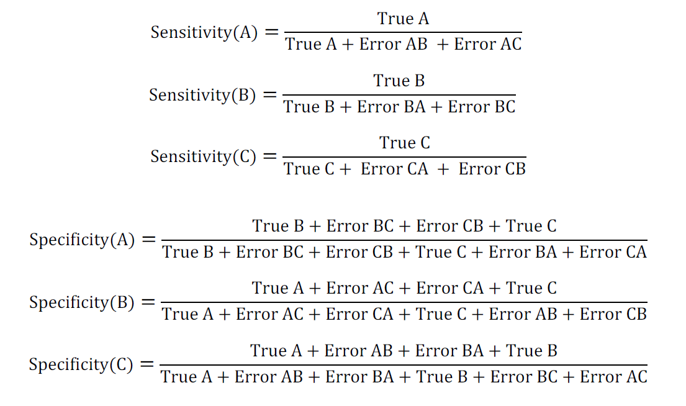
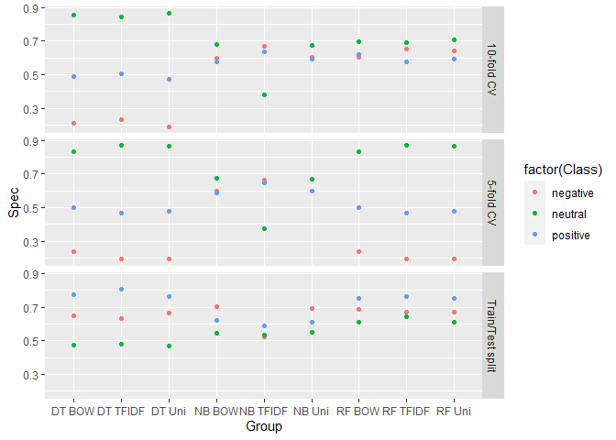
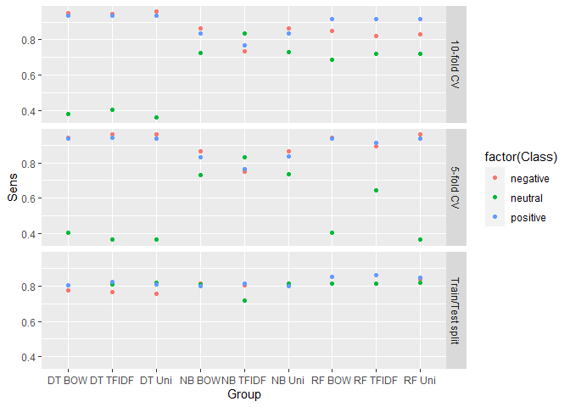
Sensitivity and Specificity of Classifiers
Sensitivity: probability of a positive test being correctly identified as a positive test
Specificity: probability of a negative test being correctly identified as a negative test

Slide 9
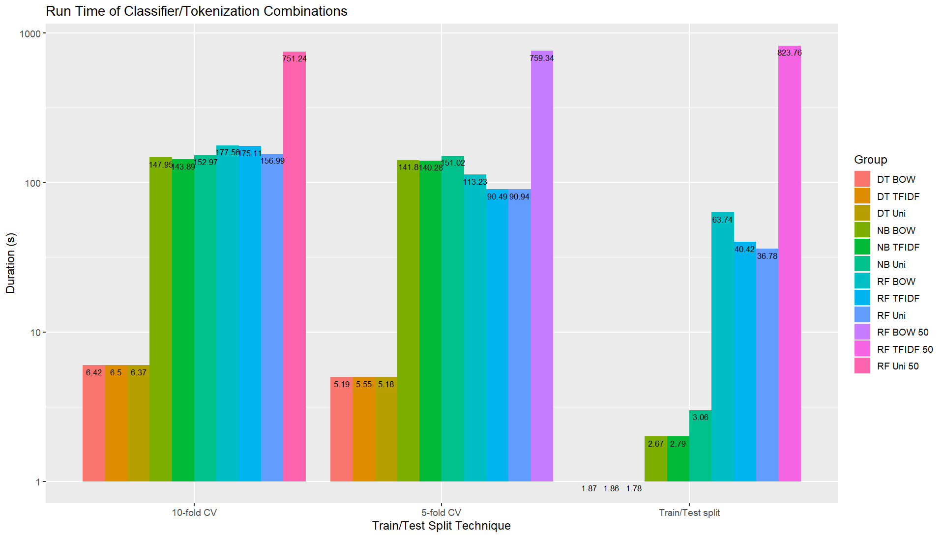
Efficiency of Classifiers
Efficiency is gauged through the run time required for a classifier to fully train and test a model

Slide 10
Conclusions and Future Work
Classifiers had a high prediction rate of the neutral sentiment class
Semantic approaches should be tested to investigate the reason for the high frequency of neutral sentiment classification
No clear “winner”; however, random forest marginally performs better than decision tree and NB
Future studies are required as stronger classifiers such as NB typically perform better
Processing power is an important factor to replicate and further this study
Any changes to the model to fine-tune and output reliable results?

Slide 11
Thank you!
The codes and resulted can be found on Github:
https://github.com/mengziii/Big-Data-Final-JS

